Slide 1
Force Sensing Module
Andy Strauss

Slide 2
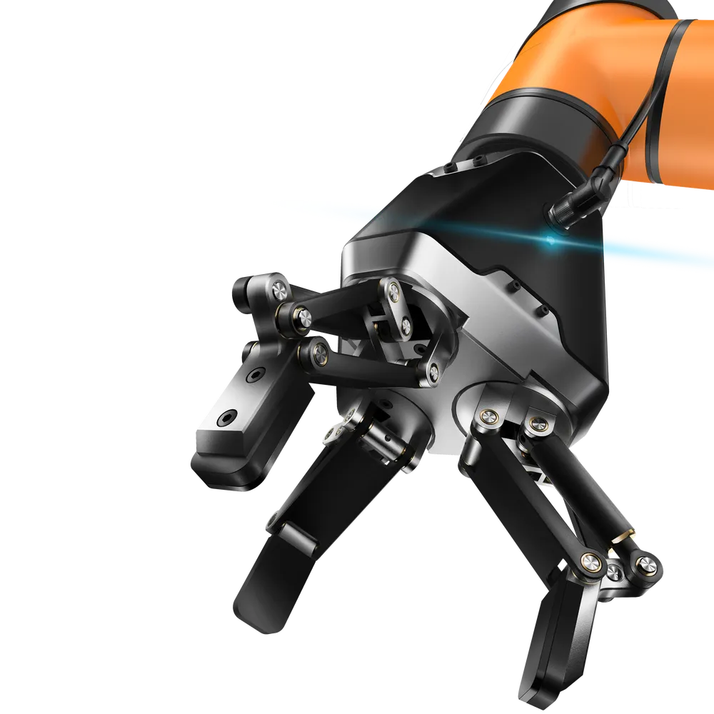
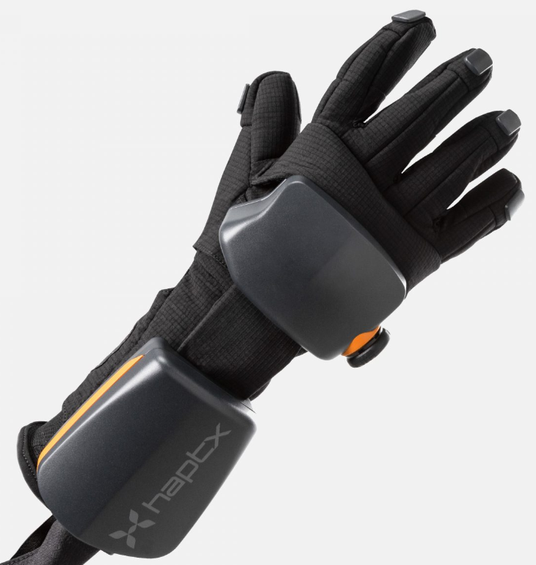
Why do we need this?
A small 3D force sensor is useful for adding observability to many types of robots.
They are particularly useful for grippers to allow for closed loop control when gripping and object.
Or to allow for feedback to a teleoperator.
https://haptx.com/

Slide 3
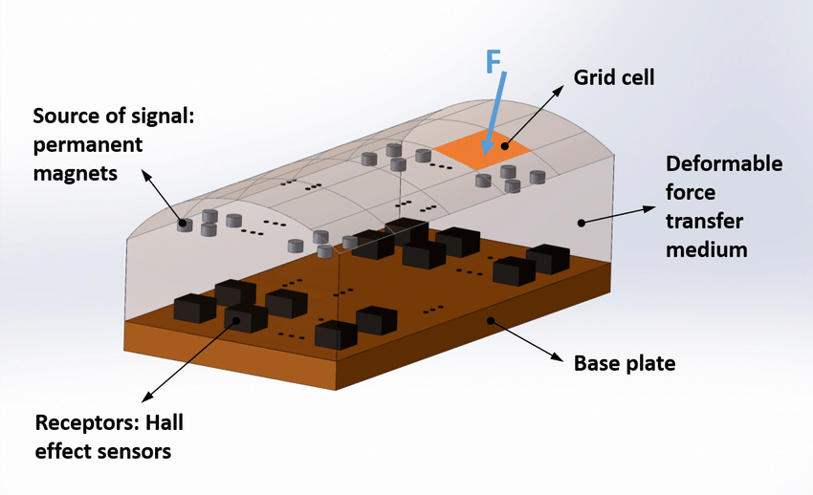
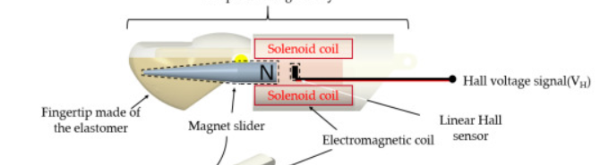
Work from other labs
Paper from Alireza Mohammadi
Uses an array of 12 hall effect sensors and 16 small magnets.
Machine learning turn the readings from the hall effect sensor into force data.
Paper from Seo MJ
1D hall effect sensor to sense the deformation of a fingertip.
Hall effect sensor is placed in the finger structure and a magnetic rigid component joins that to a fingertip which can be deformed.

Slide 4
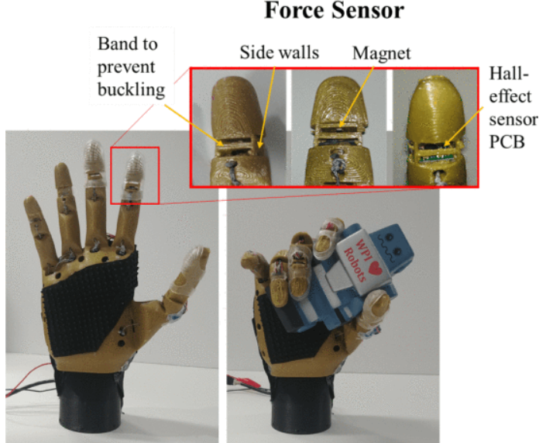
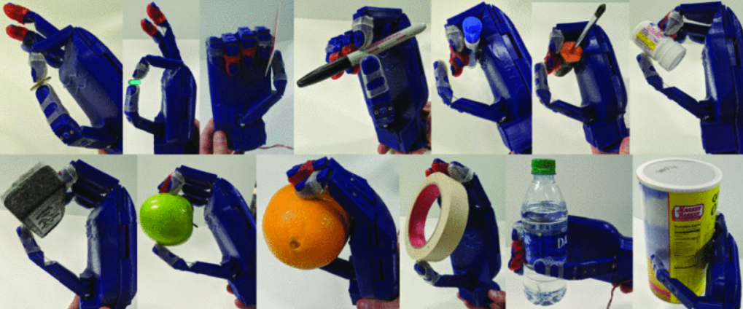
Previous work in our lab
Our lab had previously created a force sensitive robot hand and also a force sensing module
Couple issues:
Both are not robust
Force sensor was difficult to read because wasn’t constrained properly

Slide 5
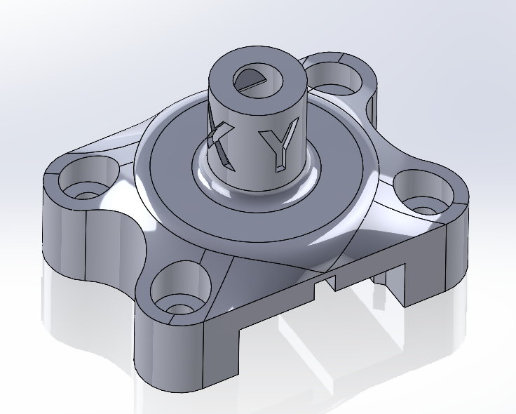
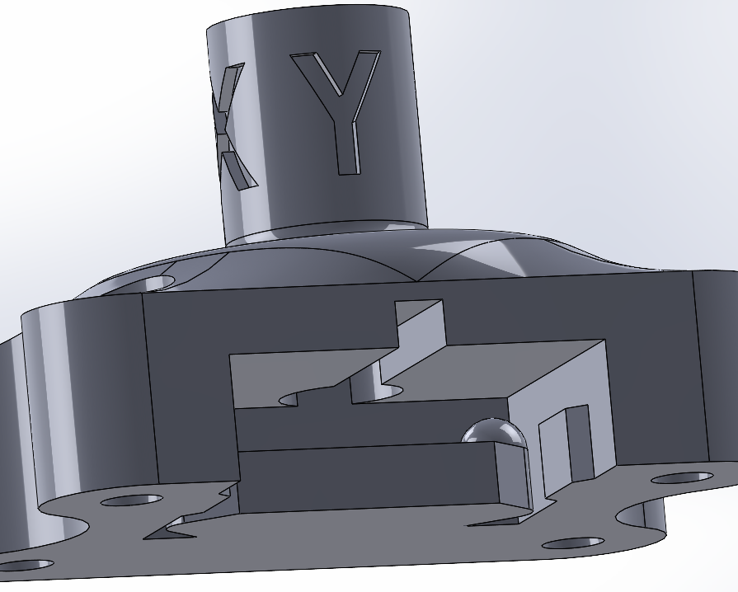
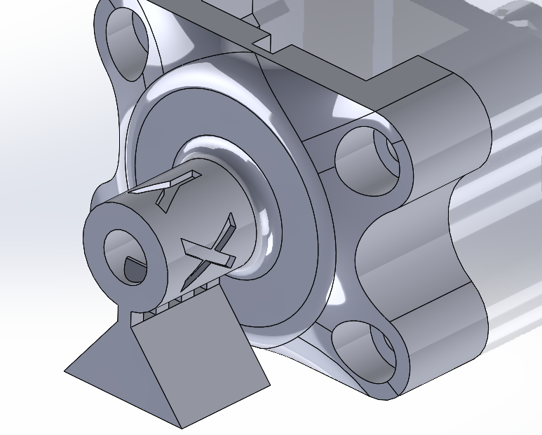
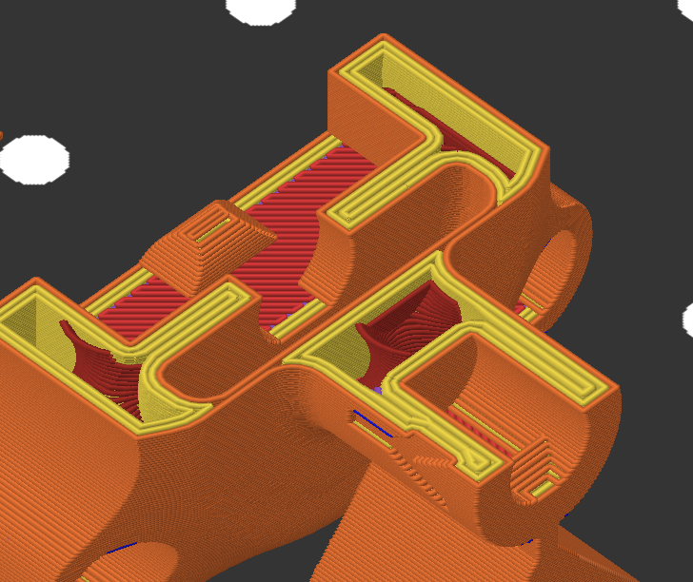
Design
Design Goals:
Easy to fabricate
Easy to tune
Easy to assemble
Important Functional Considerations:
Placement of the hall sensor
Thickness and diameter of the membrane
Distance that the stick holds the magnet away from the hall sensor

Slide 6
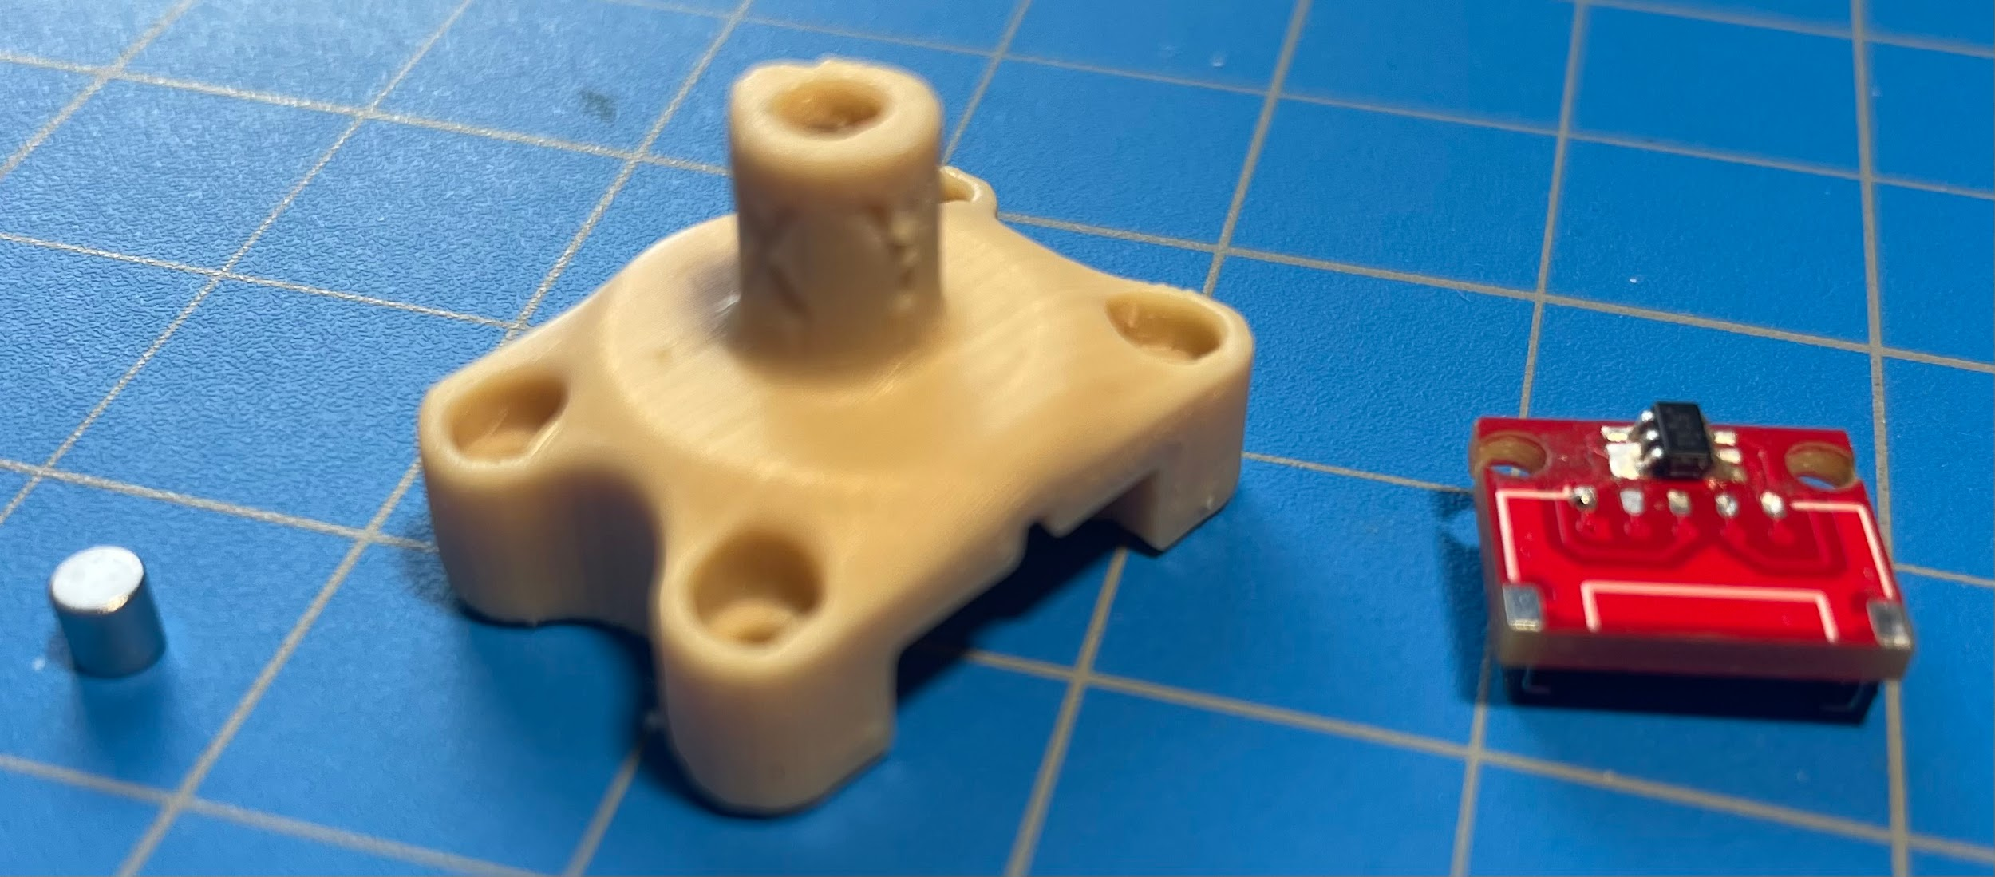
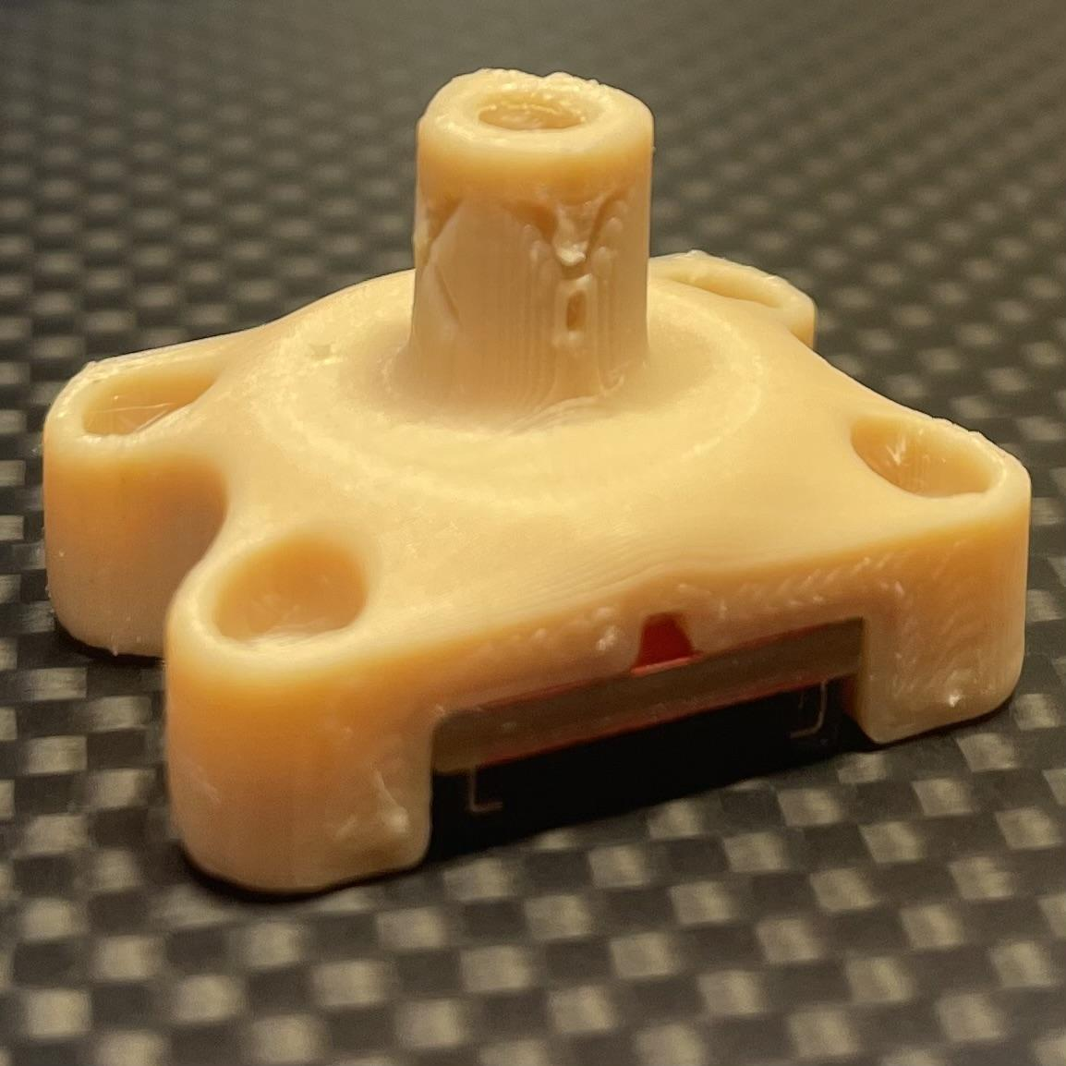
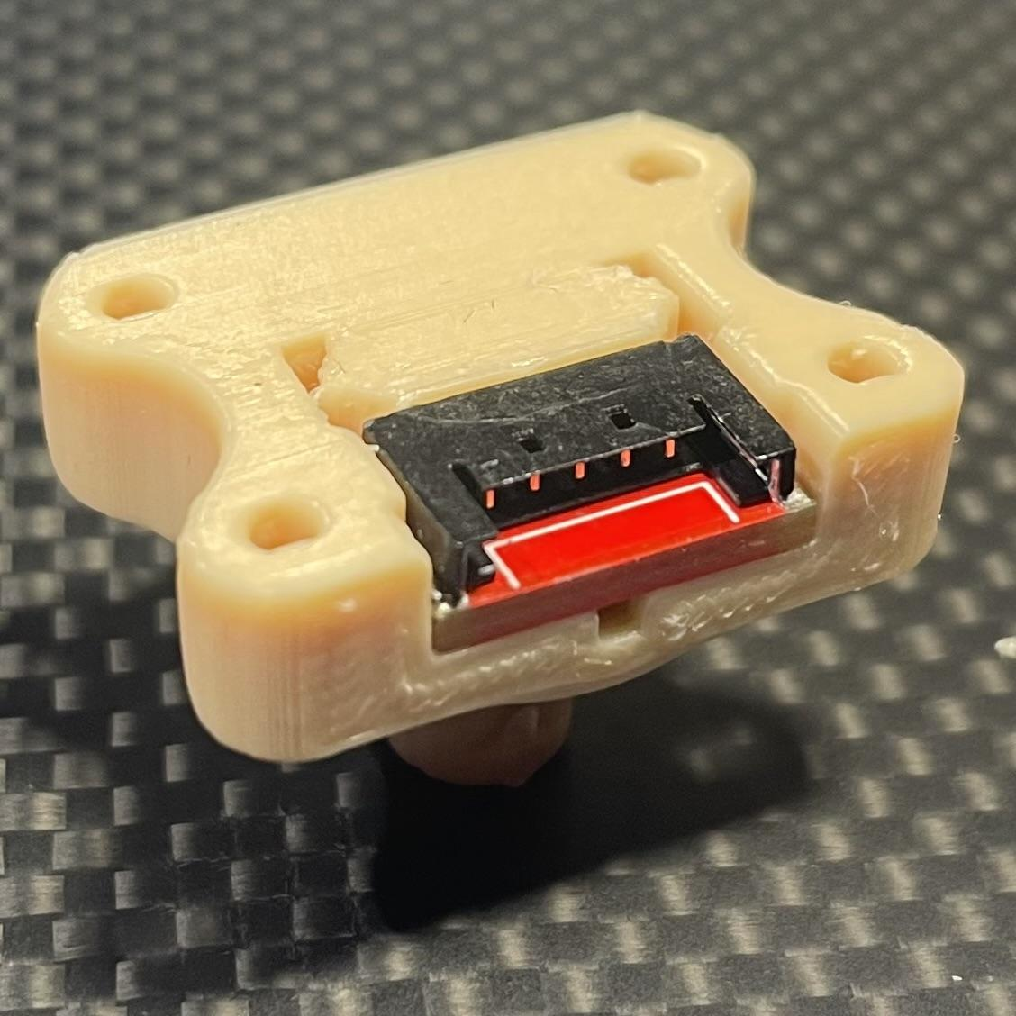
Design Close ups

Slide 7
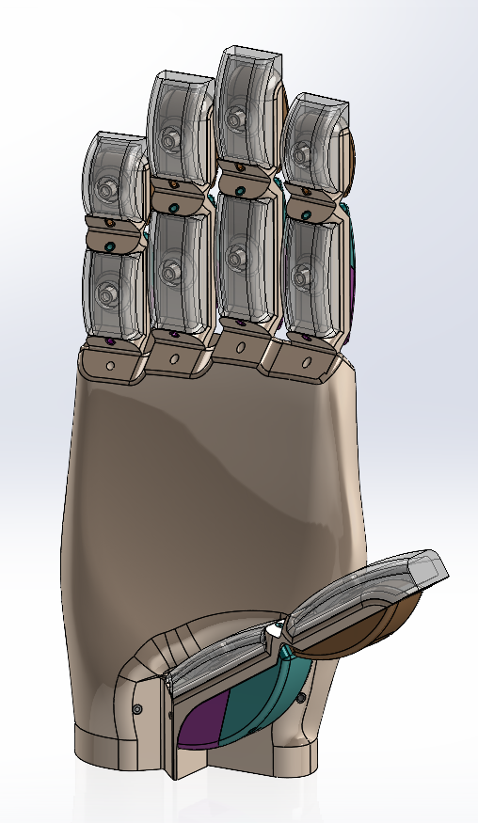
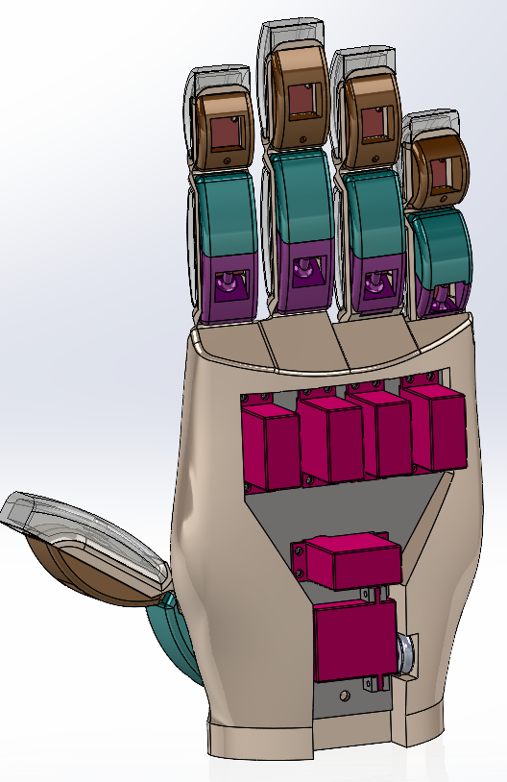
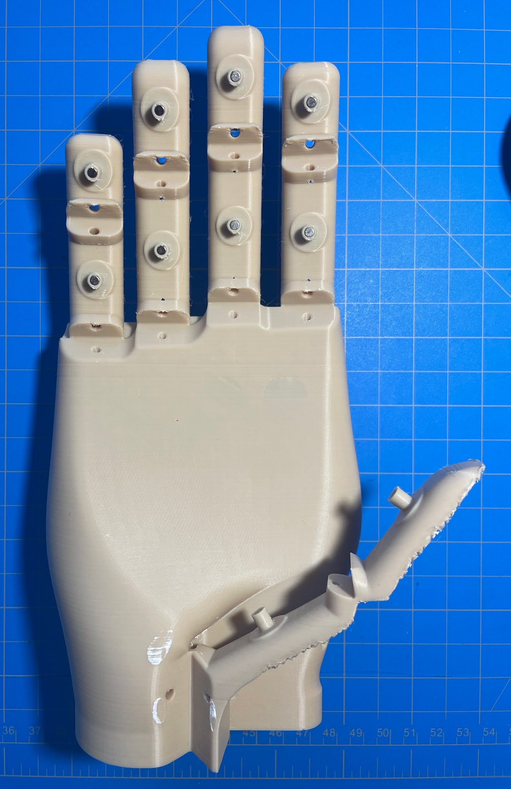
Hand Design

Slide 8
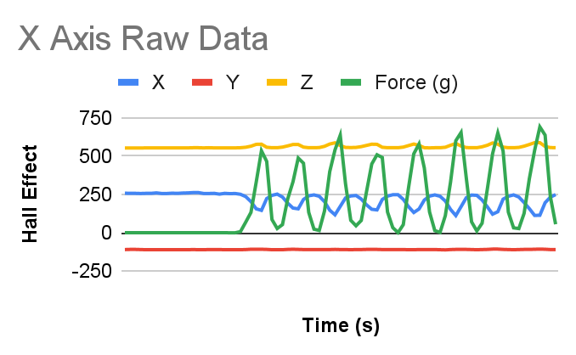
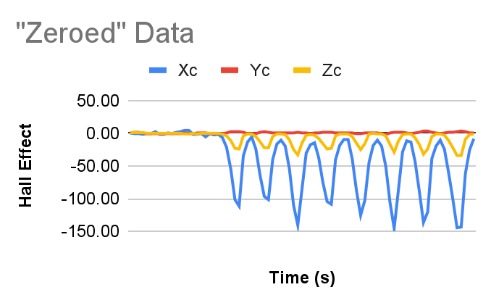
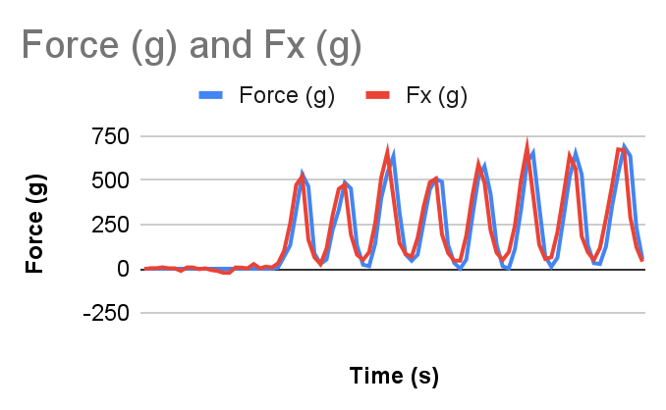
Data Analysis
Eq.1
Eq.2
Eq.3
Eq.4
Cxy = avg(Yc)/avg(Xc), Cxz = avg(Zc)/avg(Xc) | Eq.1
Xp=Xc - Cxy*Yc-Cxz*Zc | Eq.2
Cfx = avg(F)/avg(Xp) | Eq.3
Fx = Cfx*Xp | Eq.4

Slide 9
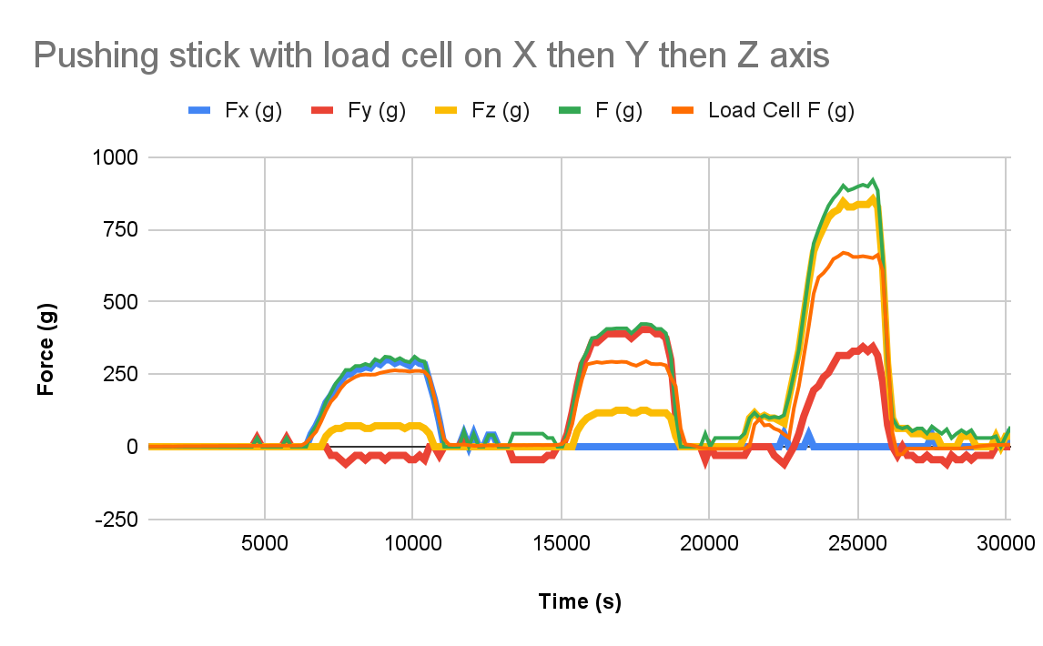
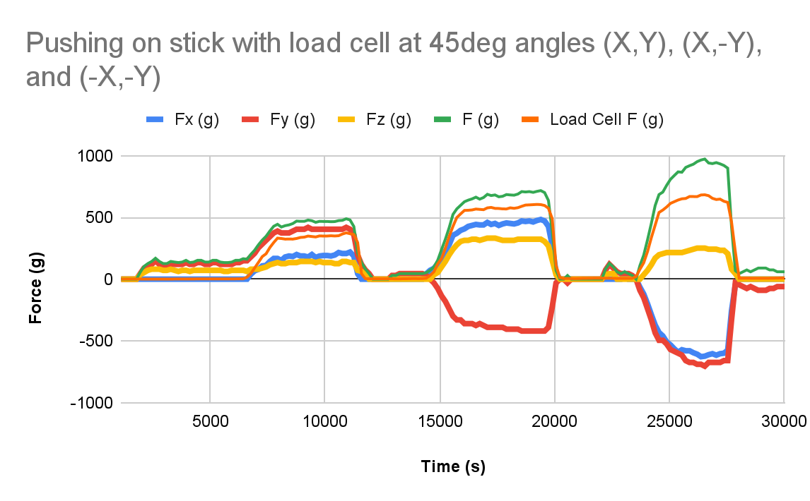
Results
X offset | 216.152 | Cxy | 0.015 | Cxz | -0.071 | Cfx | -4.226
Y offset | -123.468 | Cyx | 0.016 | Cyz | -0.154 | Cfy | -15.422
Z offset | 615.094 | Czx | 0.283 | Czy | -0.21 | Cfz | 9.264

Slide 10
Future work
Sensor:
Hall effect sensor doesn't need to be the center of that hemisphere meaning there could be an alternative design that places the magnet and stick on the other side of the membrane
Hand:
More extensive testing of the tuning parameters for the smaller integrated sensor.
Programming to control the servo motors on the hand

Slide 11
Bibliography
A. M. Votta et al., "Kinematic Optimization of an Underactuated Anthropomorphic Prosthetic Hand," 2020 IEEE/RSJ International Conference on Intelligent Robots and Systems (IROS), Las Vegas, NV, USA, 2020, pp. 3397-3403, doi: 10.1109/IROS45743.2020.9341640.
Mohammadi A, Xu Y, Tan Y, Choong P, Oetomo D. Magnetic-based Soft Tactile Sensors with Deformable Continuous Force Transfer Medium for Resolving Contact Locations in Robotic Grasping and Manipulation. Sensors (Basel). 2019 Nov 12;19(22):4925. doi: 10.3390/s19224925. PMID: 31726702; PMCID: PMC6891814.
Seo MJ, Yoo JC. Omnidirectional Fingertip Pressure Sensor Using Hall Effect. Sensors (Basel). 2021 Oct 25;21(21):7072. doi: 10.3390/s21217072. PMID: 34770376; PMCID: PMC8587916.
S. Li, R. Rameshwar, A. M. Votta and C. D. Onal, "Intuitive Control of a Robotic Arm and Hand System With Pneumatic Haptic Feedback," in IEEE Robotics and Automation Letters, vol. 4, no. 4, pp. 4424-4430, Oct. 2019, doi: 10.1109/LRA.2019.2937483.

